Slide 1
18CSC202J - OBJECT ORIENTED DESIGN AND PROGRAMMING Session 3 Topic : Stack, Associative containers:Map,MultiMap

Slide 2
STL Stack
Stacks are a type of container adaptors with LIFO(Last In First Out) type of working, where a new element is added at one end and (top) an element is removed from that end only.

Slide 3
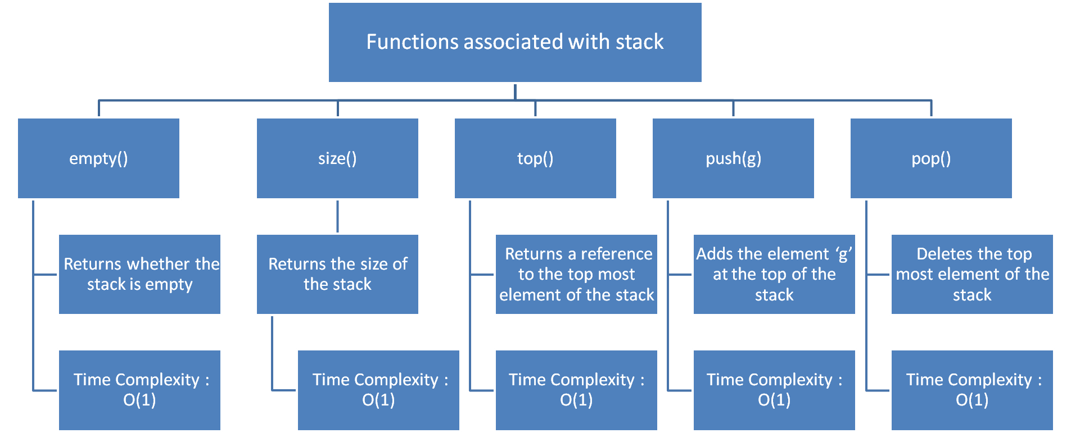

Slide 4
// CPP program to demonstrate working of STL stack
#include <iostream>
#include <stack>
using namespace std;
void showstack(stack <int> s)
{
while (!s.empty())
{
cout << '\t' << s.top();
s.pop();
}
cout << '\n';
}
int main ()
{
stack <int> s;
s.push(10);
s.push(30);
s.push(20);
s.push(5);
s.push(1);
cout << "The stack is : ";
showstack(s);
cout << "\ns.size() : " << s.size();
cout << "\ns.top() : " << s.top();
cout << "\ns.pop() : ";
s.pop();
showstack(s);
return 0;
}
Output:
The stack is : 1 5 20 30 10
s.size() : 5
s.top() : 1
s.pop() : 5 20 30 10

Slide 5
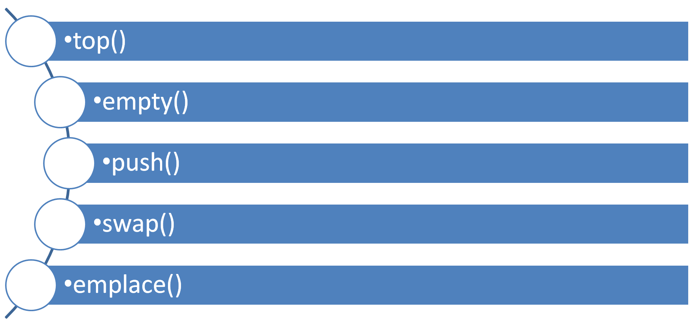
List of functions of Stack

Slide 6
Associative containers
Map and Multimap

Slide 7
Associative containers
They implement sorted data structures that can be quickly searched (O(log n) complexity).

Slide 8
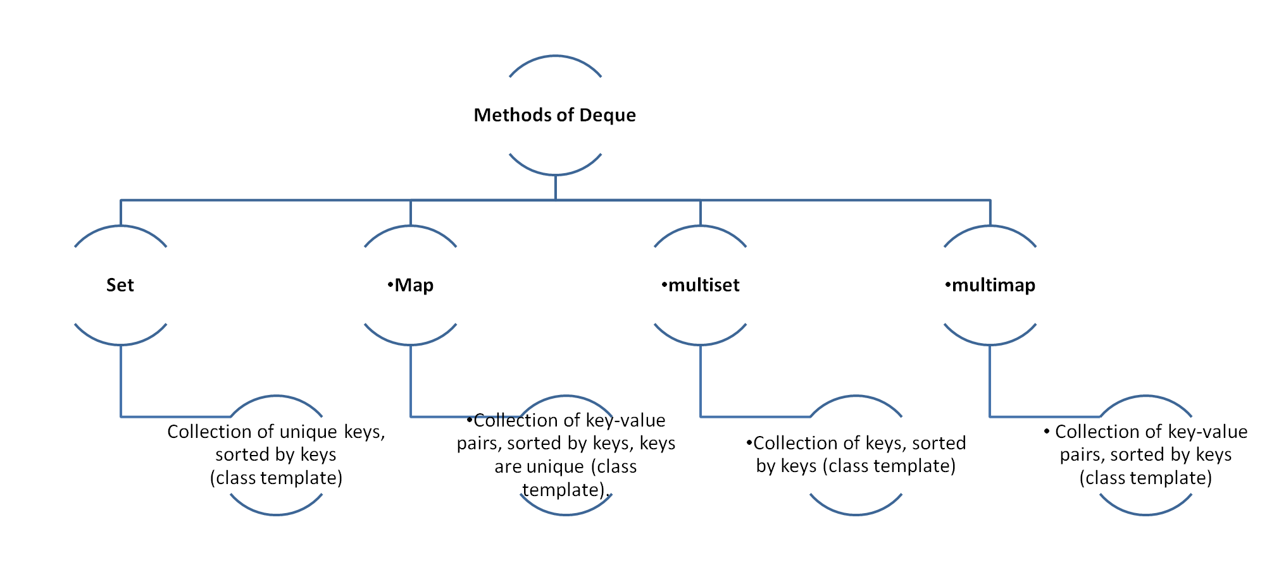
Methods of Deque

Slide 9
Associative containers: Map
Maps are associative containers that store elements in a mapped fashion.
Each element has a key value and a mapped value. No two mapped values can have same key values.

Slide 10
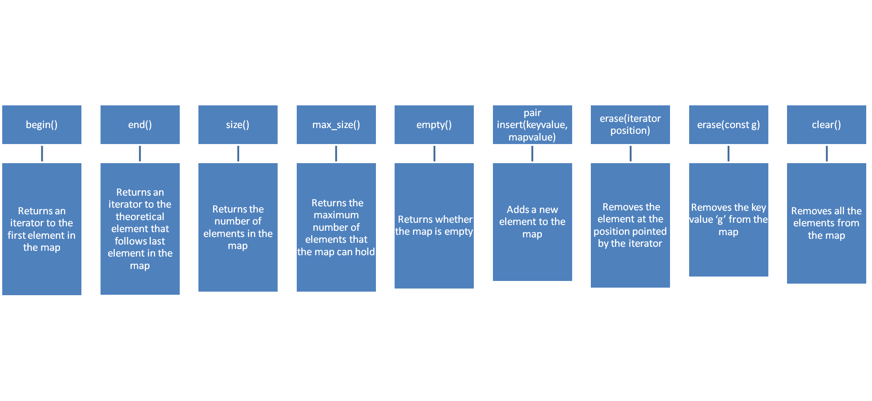
basic functions associated with Map

Slide 11
Associative containers: Multimap
Multimap is similar to map with an addition that multiple elements can have same keys. Rather than each element being unique, the key value and mapped value pair has to be unique in this case.

Slide 12
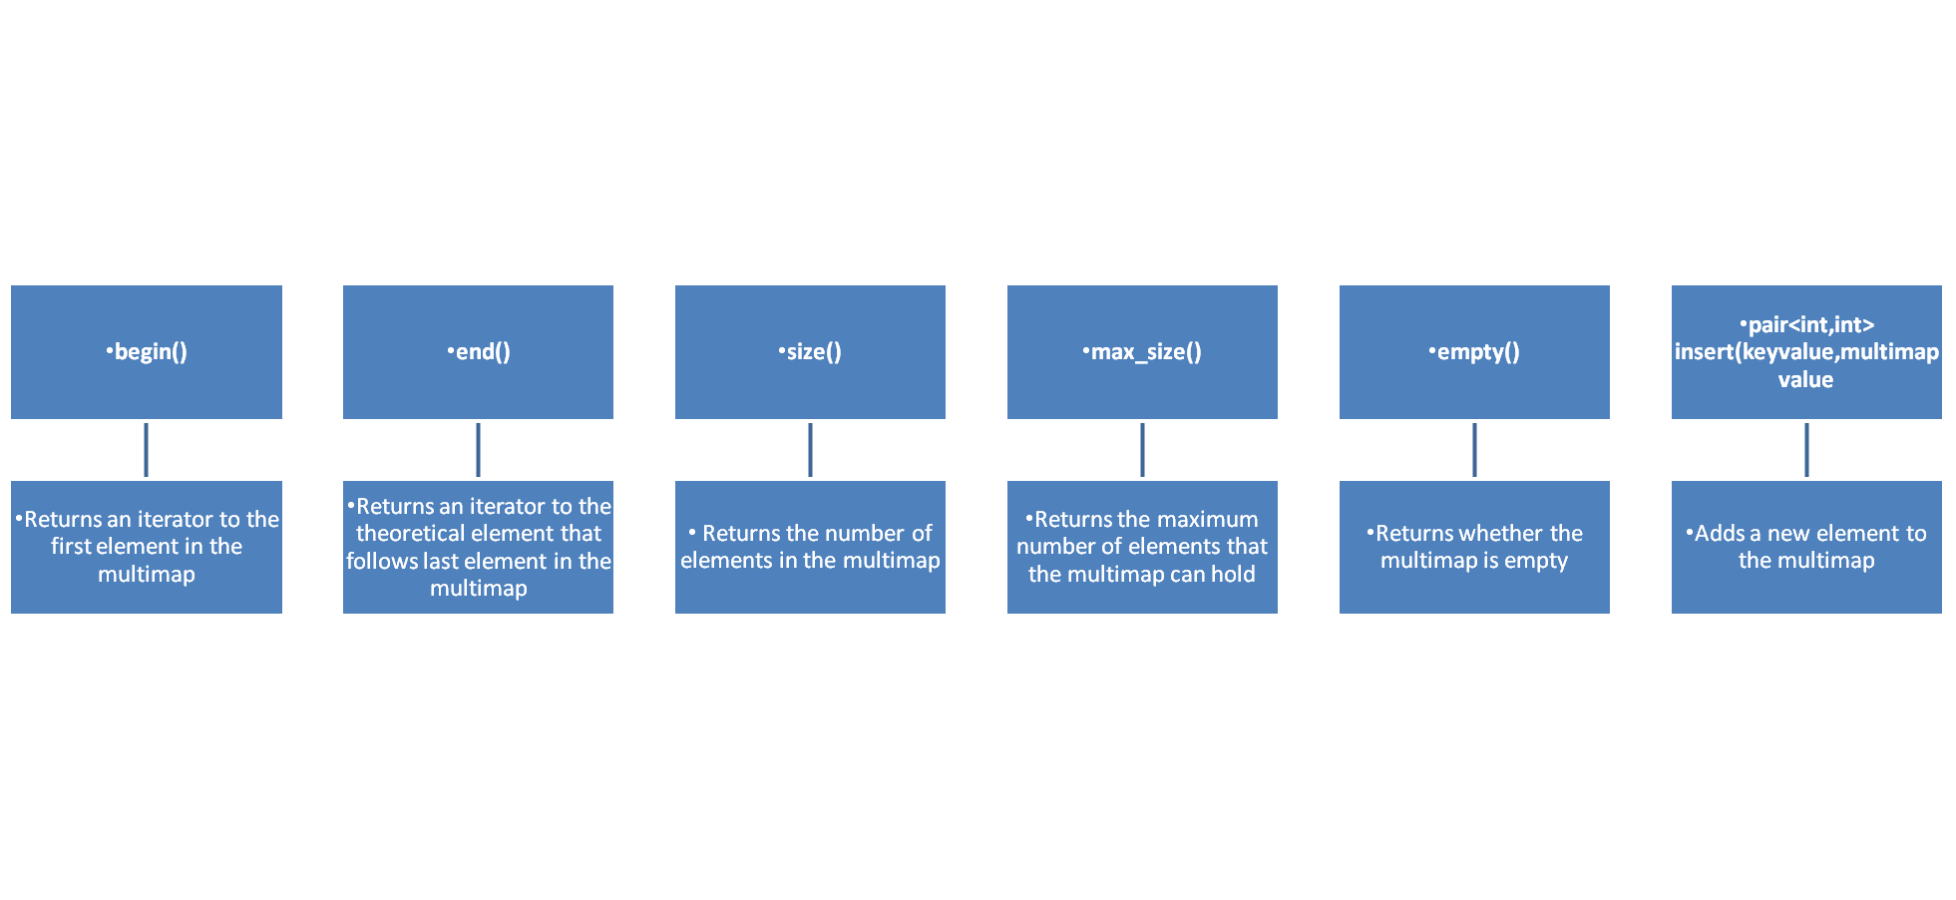
basic functions associated with multiMap

Slide 13
#include <iostream>
#include <map>
#include <iterator>
using namespace std;
int main()
{
multimap <int, int> gquiz1; // empty multimap container
// insert elements in random order
gquiz1.insert(pair <int, int> (1, 40));
gquiz1.insert(pair <int, int> (2, 30));
gquiz1.insert(pair <int, int> (3, 60));
gquiz1.insert(pair <int, int> (4, 20));
gquiz1.insert(pair <int, int> (5, 50));
gquiz1.insert(pair <int, int> (6, 50));
gquiz1.insert(pair <int, int> (6, 10));
// printing multimap gquiz1
multimap <int, int> :: iterator itr;
cout << "\nThe multimap gquiz1 is : \n";
cout << "\tKEY\tELEMENT\n";
for (itr = gquiz1.begin(); itr != gquiz1.end(); ++itr)
{
cout << '\t' << itr->first
<< '\t' << itr->second << '\n';
}
cout << endl;
// assigning the elements from gquiz1 to gquiz2
multimap <int, int> gquiz2(gquiz1.begin(),gquiz1.end());
// print all elements of the multimap gquiz2
cout << "\nThe multimap gquiz2 after assign from gquiz1 is : \n";
cout << "\tKEY\tELEMENT\n";
for (itr = gquiz2.begin(); itr != gquiz2.end(); ++itr)
{
cout << '\t' << itr->first
<< '\t' << itr->second << '\n';
}
cout << endl;
// remove all elements up to element with value 30 in gquiz2
cout << "\ngquiz2 after removal of elements less than key=3 : \n";
cout << "\tKEY\tELEMENT\n";
gquiz2.erase(gquiz2.begin(), gquiz2.find(3));
for (itr = gquiz2.begin(); itr != gquiz2.end(); ++itr)
{
cout << '\t' << itr->first
<< '\t' << itr->second << '\n';
}
// remove all elements with key = 4
int num;
num = gquiz2.erase(4);
cout << "\ngquiz2.erase(4) : ";
cout << num << " removed \n" ;
cout << "\tKEY\tELEMENT\n";
for (itr = gquiz2.begin(); itr != gquiz2.end(); ++itr)
{
cout << '\t' << itr->first
<< '\t' << itr->second << '\n';
}
cout << endl;
//lower bound and upper bound for multimap gquiz1 key = 5
cout << "gquiz1.lower_bound(5) : " << "\tKEY = ";
cout << gquiz1.lower_bound(5)->first << '\t';
cout << "\tELEMENT = " << gquiz1.lower_bound(5)->second << endl;
cout << "gquiz1.upper_bound(5) : " << "\tKEY = ";
cout << gquiz1.upper_bound(5)->first << '\t';
cout << "\tELEMENT = " << gquiz1.upper_bound(5)->second << endl;
return 0;
}

Slide 14
Output:
The multimap gquiz1 is :
KEY ELEMENT
1 40
2 30
3 60
4 20
5 50
6 50
6 10
The multimap gquiz2 after assign from gquiz1 is :
KEY ELEMENT
1 40
2 30
3 60
4 20
5 50
6 50
6 10
gquiz2 after removal of elements less than key=3 :
KEY ELEMENT
3 60
4 20
5 50
6 50
6 10
gquiz2.erase(4) : 1 removed
KEY ELEMENT
3 60
5 50
6 50
6 10
gquiz1.lower_bound(5) : KEY = 5 ELEMENT = 50
gquiz1.upper_bound(5) : KEY = 6 ELEMENT = 50

